Slide 1
Preliminary HFIR 2023 Results
9/15/2023

Slide 2
Advantages to compared to Dusan’s setup
Non-adiabatic transitions between magnetic field regions -> greater control of generated state
MWPs with cryocups (i.e. accelerator coils [AC coils]/phase adjustment coils [PACs]) and nutators allow for spherical neutron polarimetry (SNP): can prepare the spin state in an arbitrary direction and measure the spin component in an arbitrary direction
Accelerator coils can shift the pattern up/down and left/right by controlling the relative phase between the two spin states
Phase focusing allows us to use a divergent beam
Stronger fields leads to smaller periods
Minimum right now of 100’s microns
Depends on specific geometry of the beamline
Max MWP current is ~40 amps, but HTS films start to be penetrated at ~25 amps (35 Gauss/amp)

Slide 3
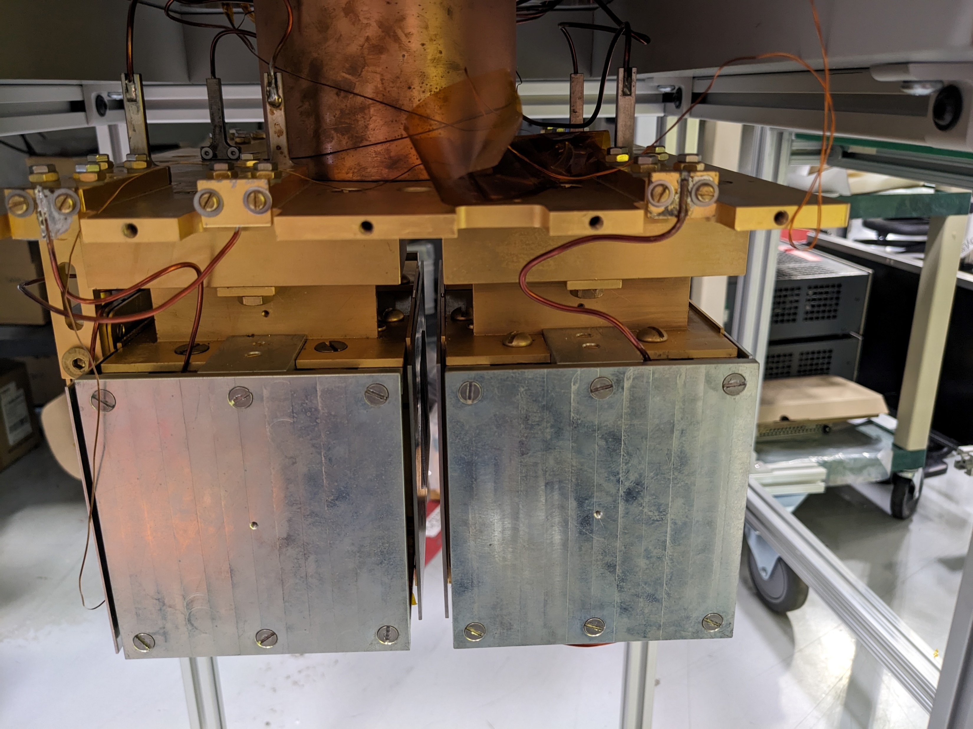
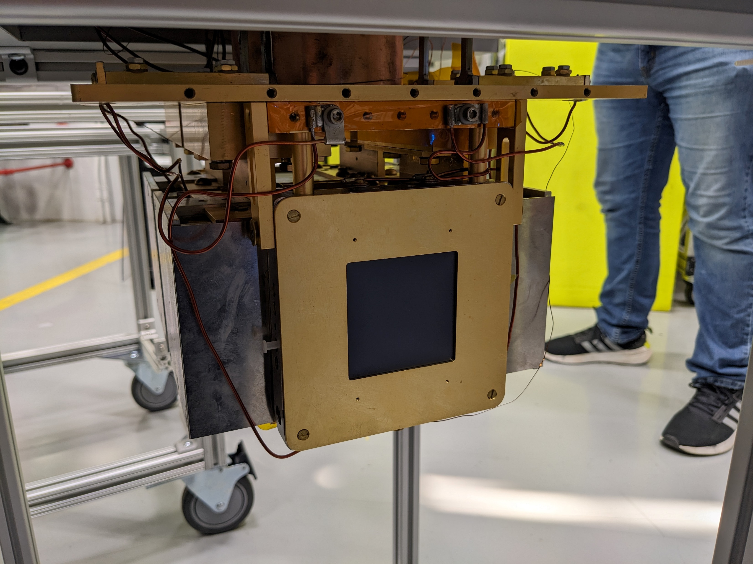
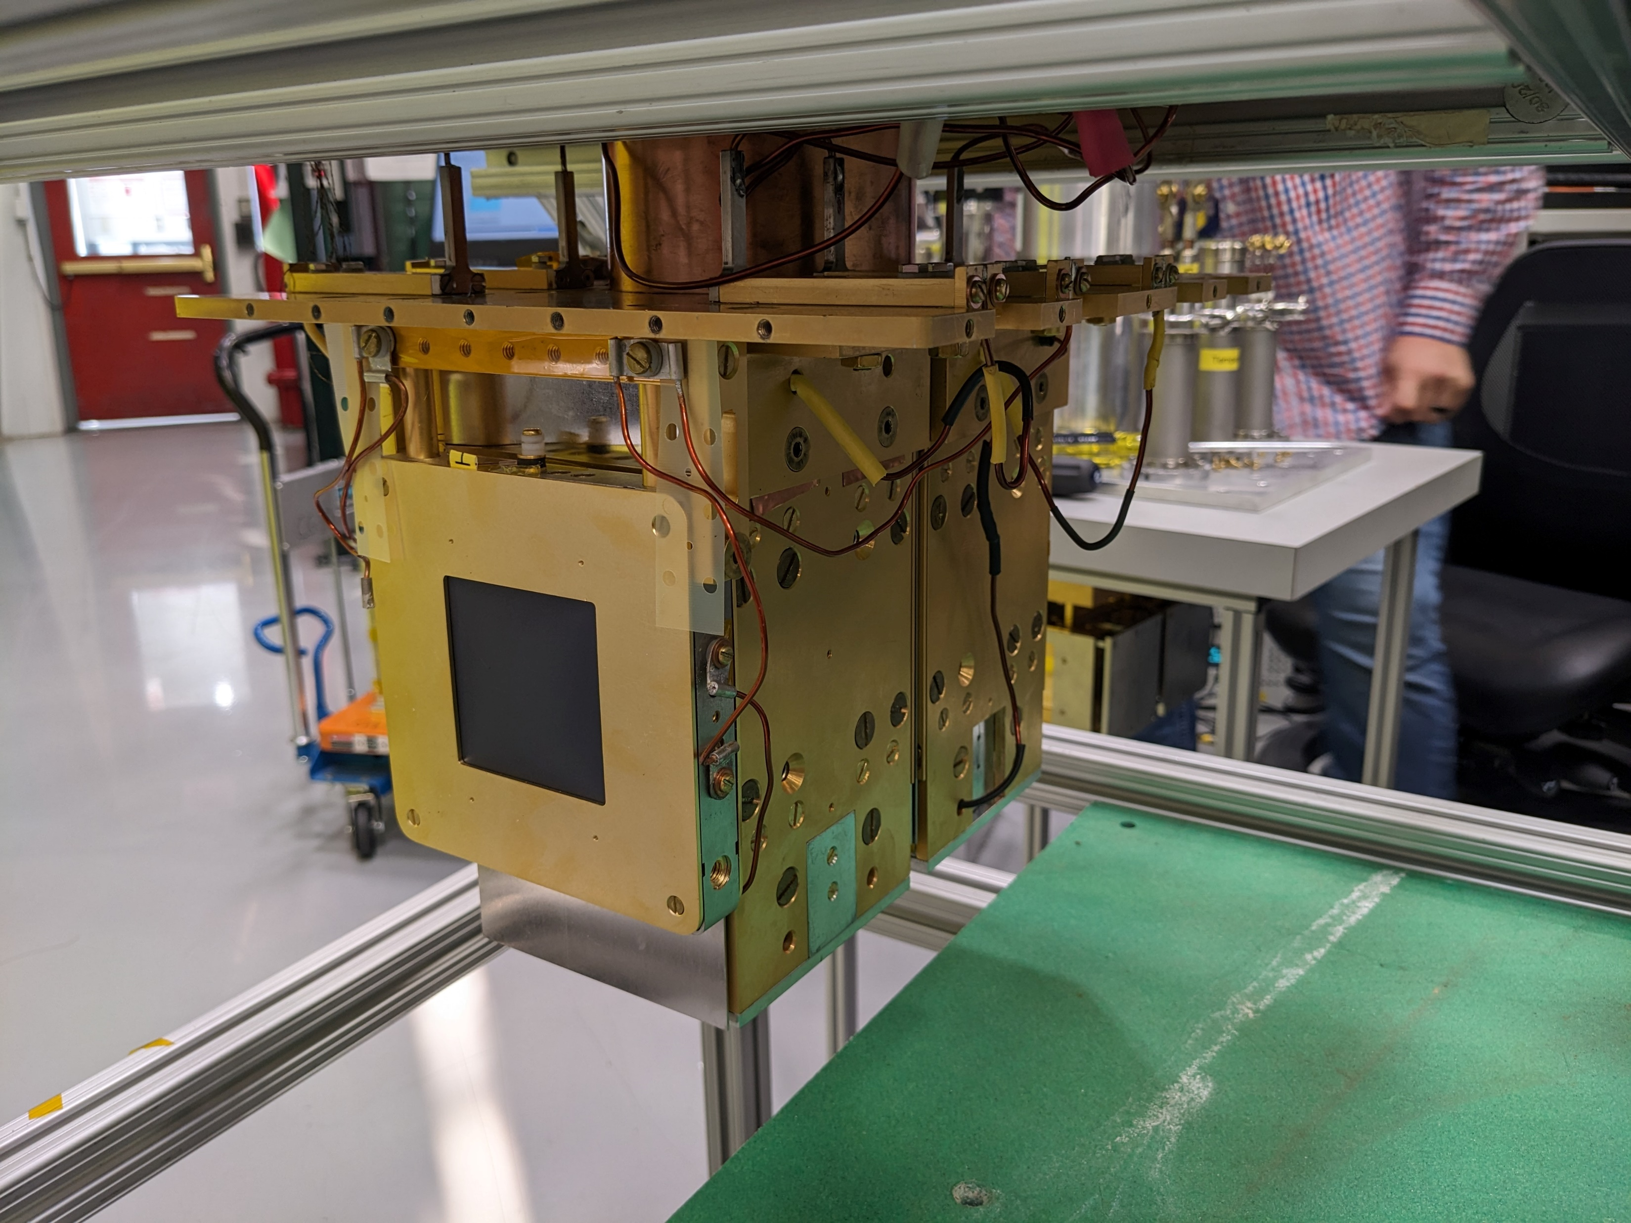
Apparatus pictures

Slide 4
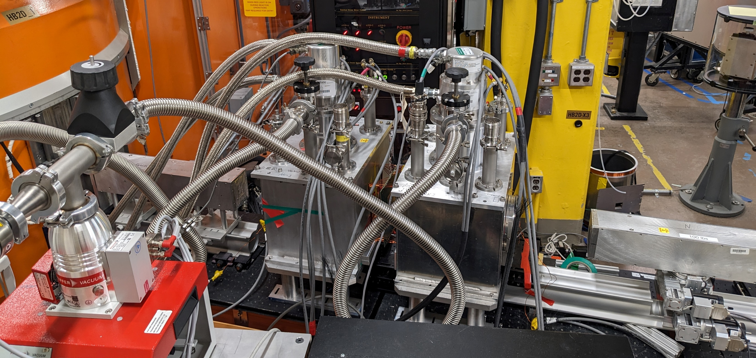
Beamline HB-2D at HFIR

Slide 5
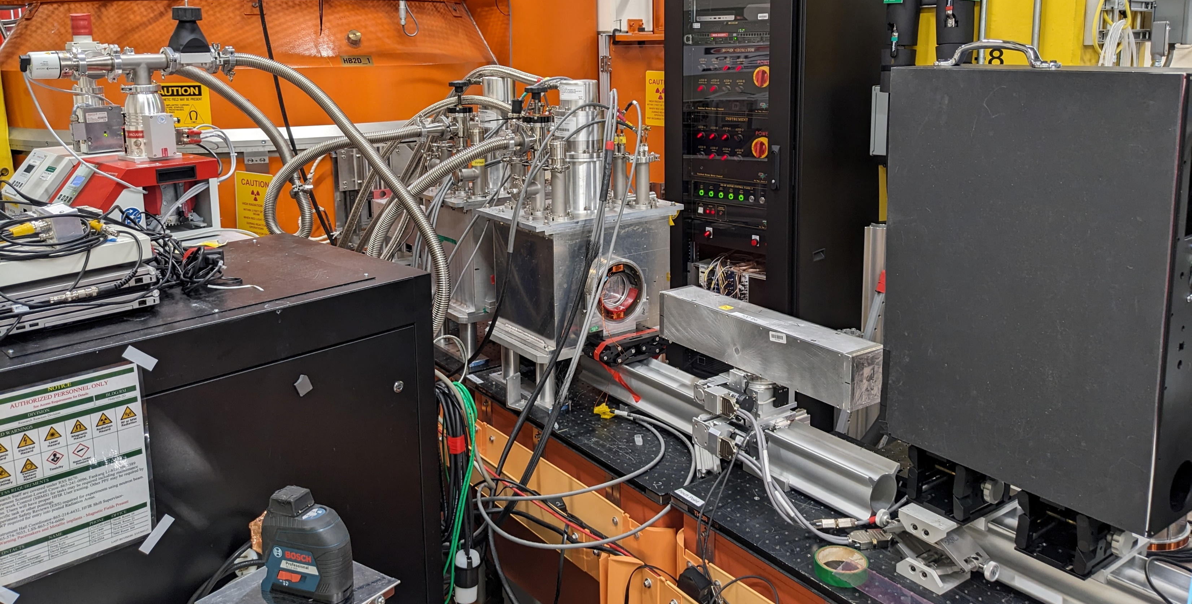

Slide 6
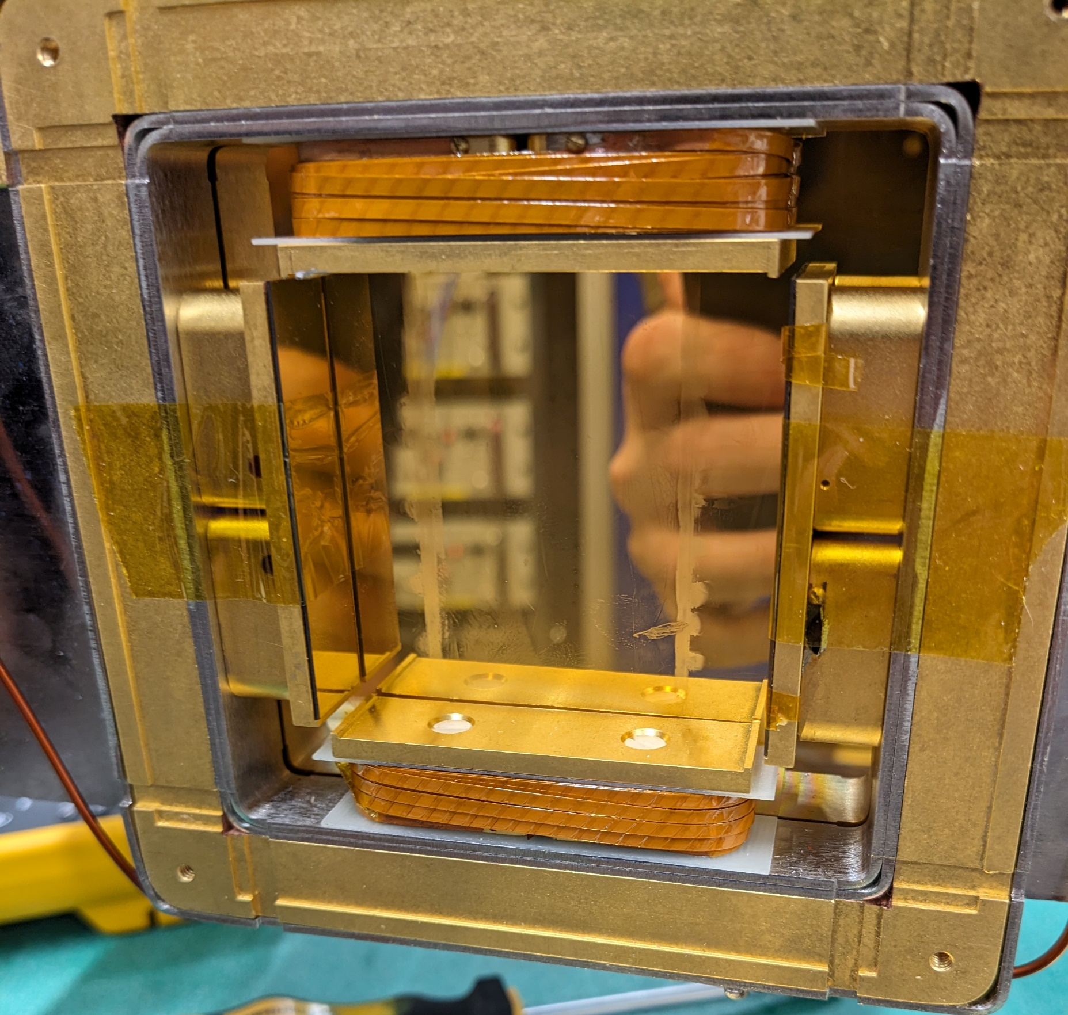
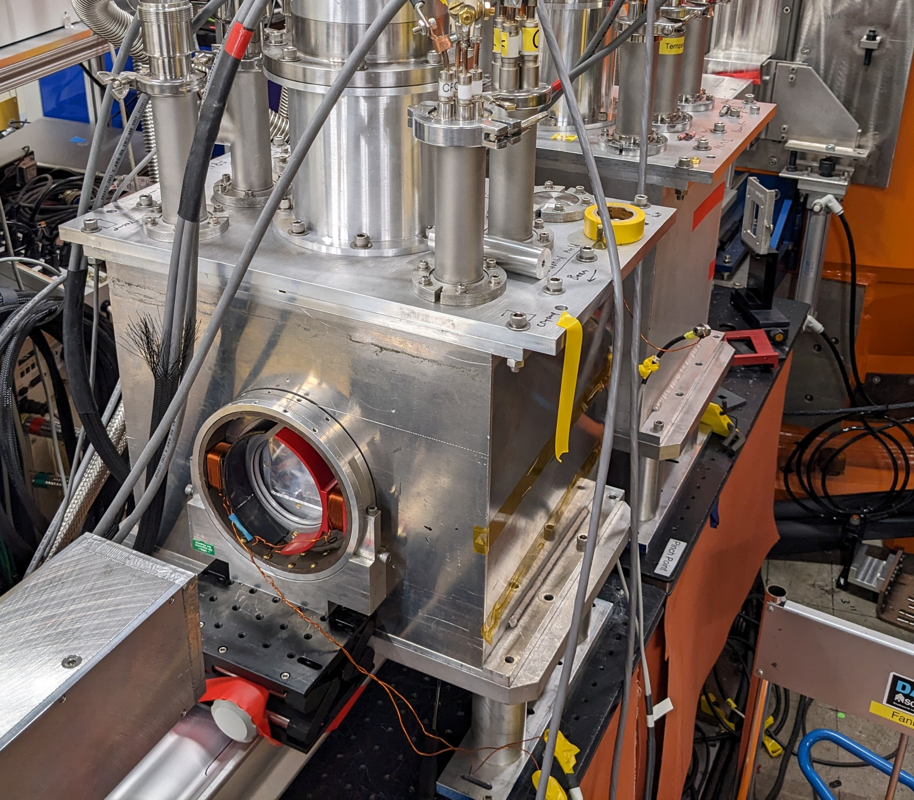
Accelerator coil and nutator pictures

Slide 7
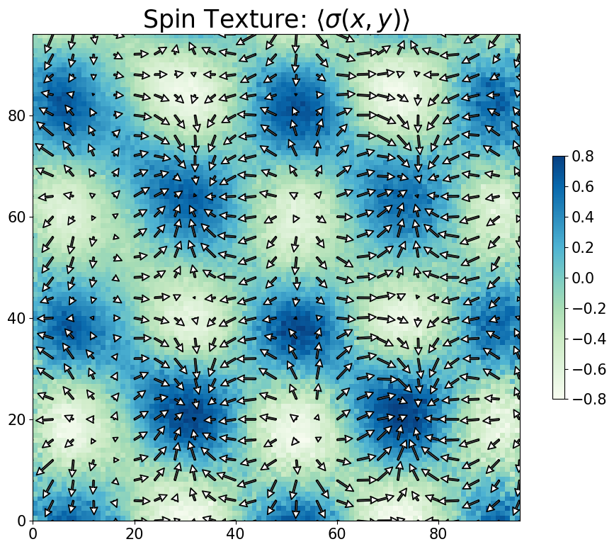
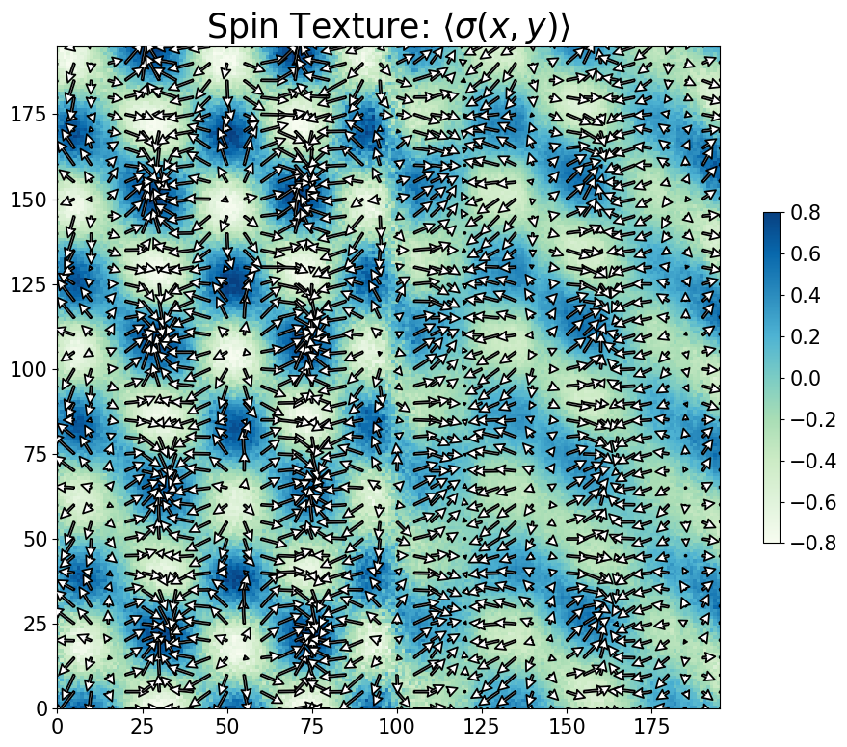
Checkerboard spin texture

Slide 8
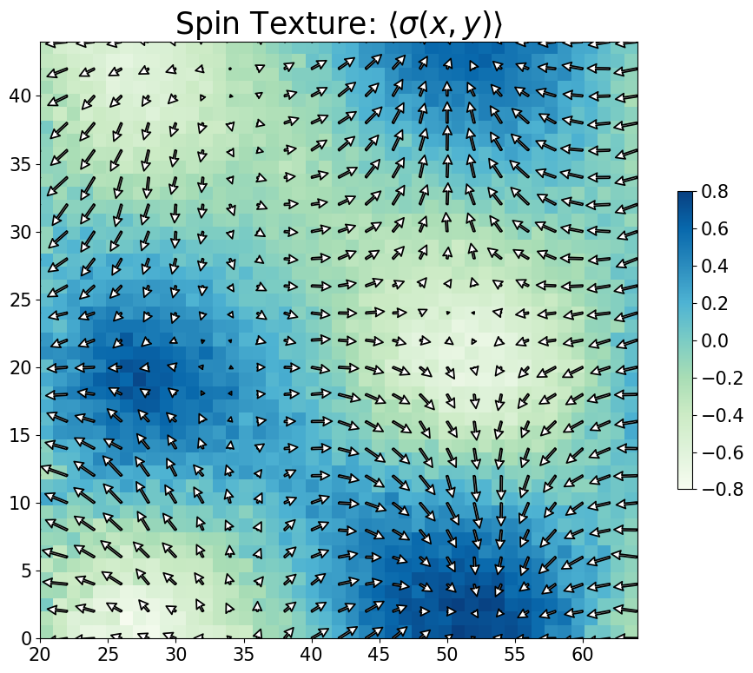
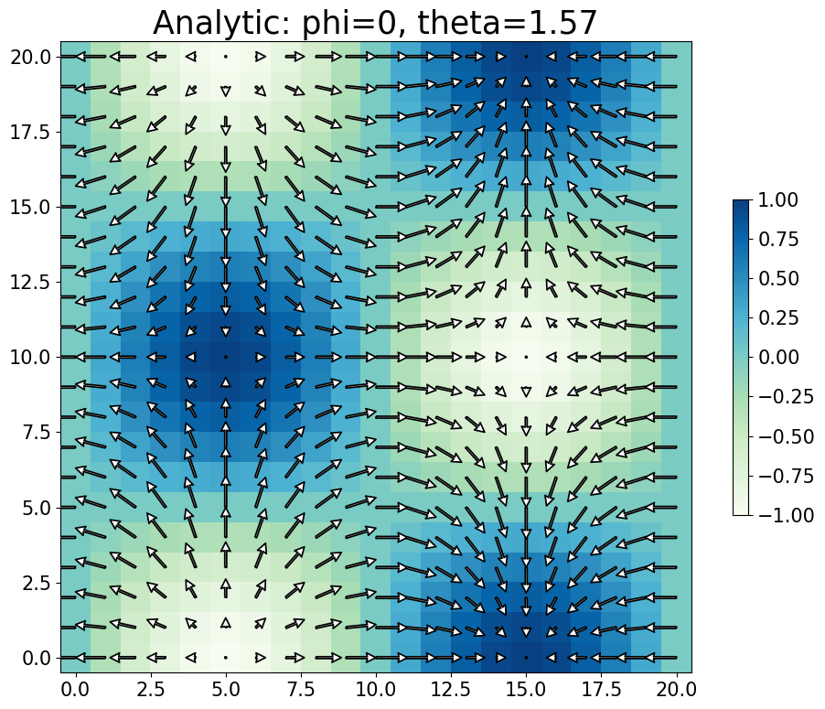
Checkerboard spin texture

Slide 9
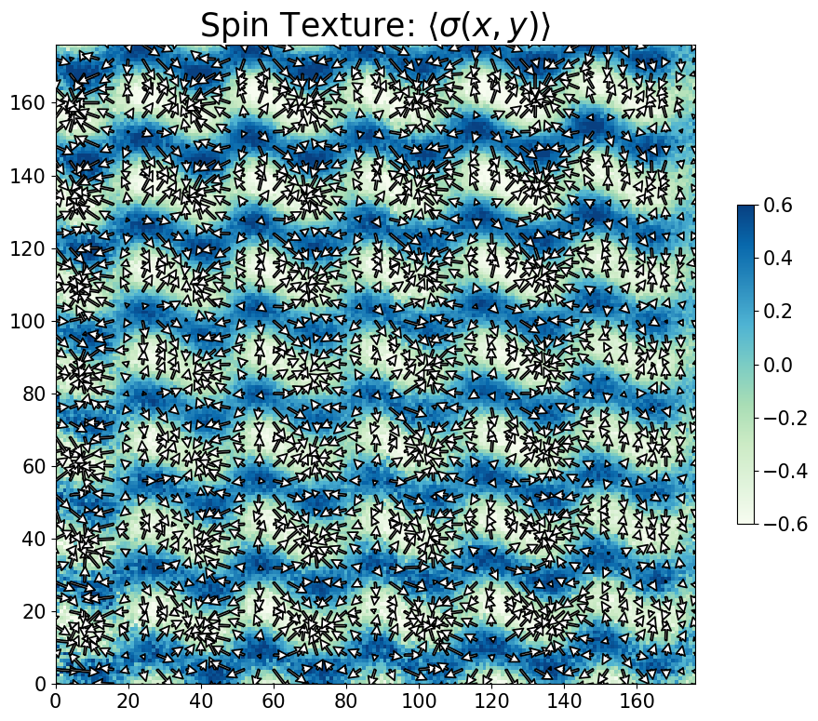
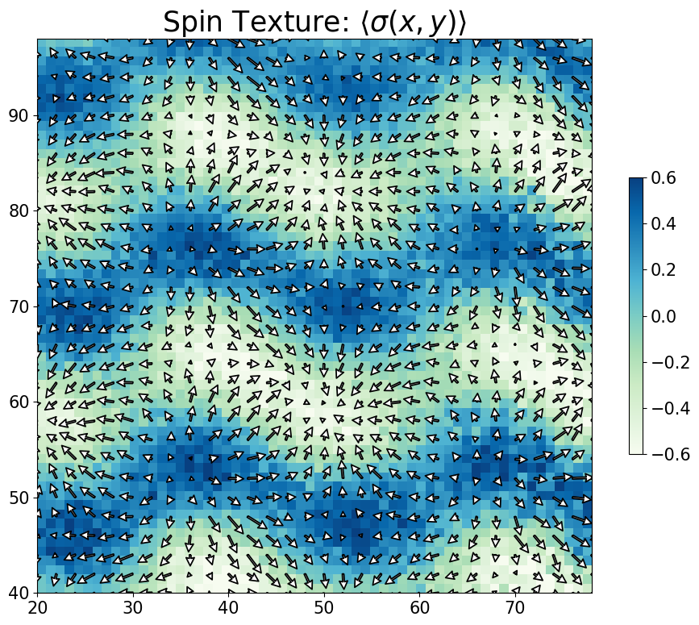
Triangular spin texture

Slide 10
